Slide 1
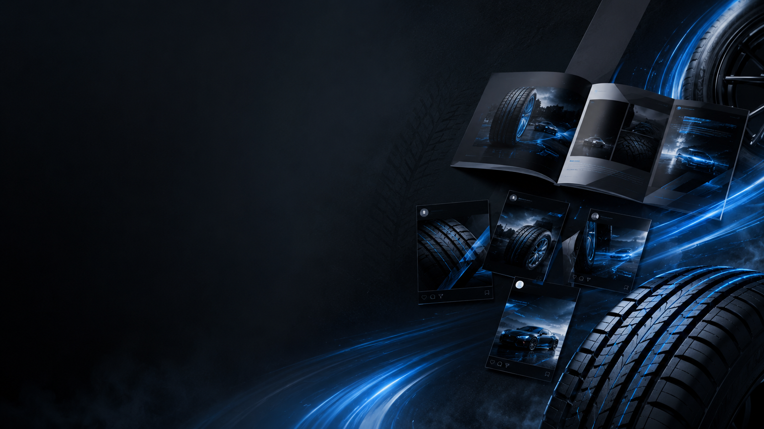
MIDWEIGHT
GRAPHIC DESIGNER
Oak Tyres UK Ltd / Davanti Tyres • Newton-le-Willows • £35,000
WHAT THEY ARE ASKING FOR
• Create premium visual assets for catalogues, brochures, flyers, signage, packaging, email, web and social media. • Bring creative concepts confidently and explain ideas clearly to stakeholders. • Follow brand guidelines while keeping the brand fresh, modern and visually consistent. • Work across multiple projects in a fast-paced marketing team and deliver to deadlines.
WHAT THIS JOB GIVES
• Creative freedom, career growth and global marketing projects. • Sporting-event/race-day opportunities and a professional creative environment.
Portfolio is essential — applications without a portfolio are not reviewed.
Notes:
Slide 1 script: This role is for a Midweight Graphic Designer at Oak Tyres UK Ltd/Davanti Tyres. The company needs someone who can design high-quality brand materials across print and digital. The key focus is creative concepts, brand consistency, communication with stakeholders, and managing deadlines in a fast-paced marketing team. The job also offers career growth, global marketing work and creative freedom.

Slide 2
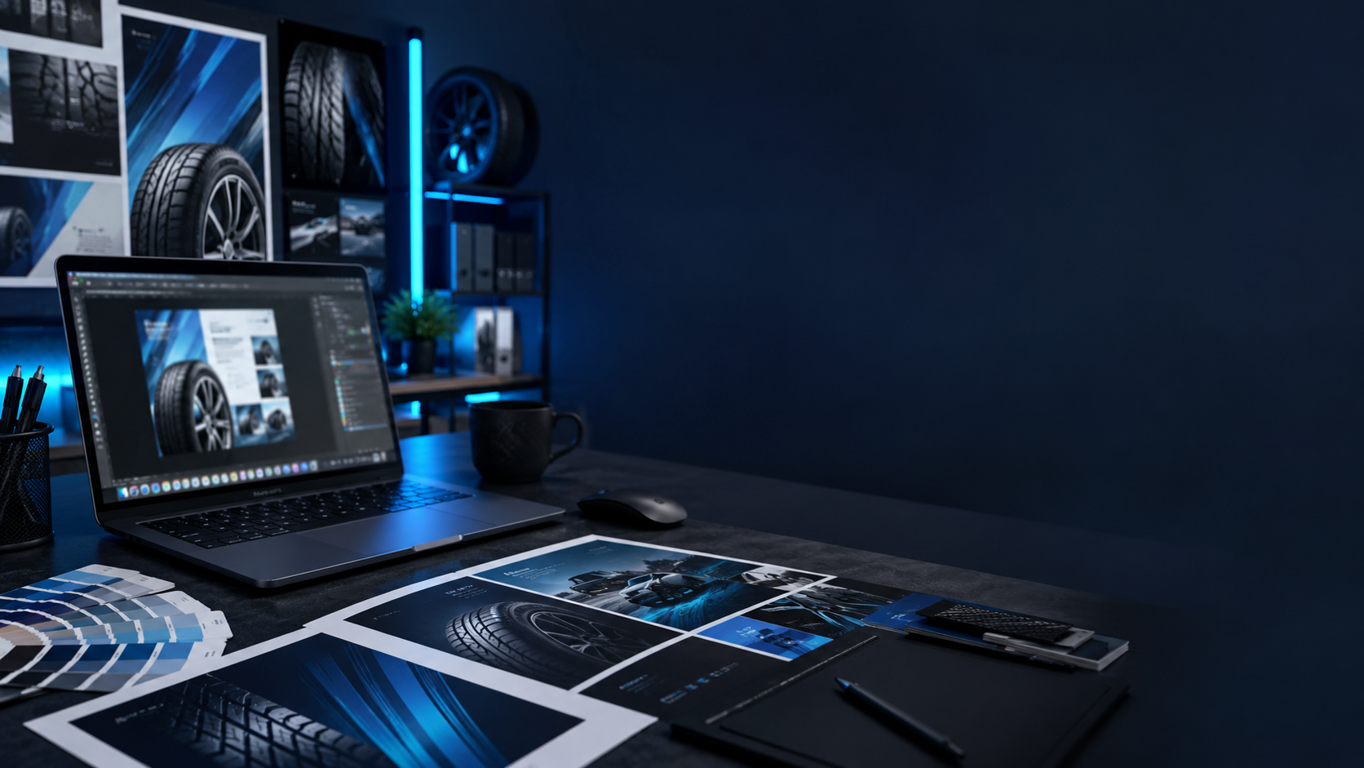
MY SKILL MATCH
Real-life Graphic Designer • Ready to create clean, premium and brand-focused visuals
THEIR REQUIREMENTS
MY GRAPHIC DESIGN SKILLS
• Adobe Creative Cloud • Brand guidelines • Typography & layout • Print + digital design • Multiple deadlines
• Photoshop, Illustrator, InDesign • Branding, logo and identity design • Social media, web assets and email templates • Catalogue, poster, flyer and packaging design • Strong attention to detail + clear communication
MY VALUE TO THE COMPANY
I can help Davanti/Oak Tyres create strong visual campaigns that look premium, stay on-brand, and connect with customers across print, digital and social platforms.
Interview message: “I combine creativity, technical design skills and attention to detail to deliver polished brand assets on time.”
Notes:
Slide 2 script: My background is graphic design, so my skills match this role strongly. I can use Adobe software, work with brand guidelines, create digital and print assets, and manage deadlines. I would bring creativity, attention to detail and clear communication to help Davanti/Oak Tyres produce professional visual designs for catalogues, signage, packaging, social media and marketing campaigns.

